Slide 1
Document Management with WebLibrary
Johnny Reusens
3FQ-40013-ABAA-TQZZA ed 19

Slide 2
Training objective
After this training, participants should be able to use the basic features of the WebLibrary tool to manage product documentation and project management documentation
Target audience
Document authors
Document reviewers
Document approval authorities
The training does not cover release authority topics, nor WebLib administration.

Slide 3
Prerequisites
Basic knowledge of Alcatel-Lucent document management concepts
Alcatel-Lucent part numbering and document type indicators
Document edition numbering
Document states
Product control plan and item categories

Slide 4
Contents
Rationale
Document management concepts
Basic features of WebLibrary
Review records in WebLibrary
Document approval and release in WebLibrary <= UPDATED
Advanced WebLibrary features
Specific features for HTML documents
Document security
Document delivery via mail (UPDATED)
Document bulk transfer
PDF as view format
Weblib as FAQ register
Weblib as Action Point register
Notification
Document read protection with ACL
Weblib philosophy
Extra Information
Management summary

Slide 5
Rationale

Slide 6
Rationale (1)
Why a document management system
Increase flexibility and reduce overhead for document authors
‘Real-time’ check-in of documents
Record review info together with the document (instead of in a separate change mgt system (DDTS, CHARTS, ...)
Improve inter-site visibility on project management and product documentation
Protect you work from accidental loss

Slide 7
Rationale (2)
Basic features of the Web Library:
Version management (check-out/in) of most documents formats
User Interface completely via Intranet and browser: easy access
Supporting functions for Document lifecycle (document status and reviews)
Search engine for title, keywords, Author, Number, Document type
Metrics
All documents are readable also in other locations
Documents can be reviewed anywhere in Alcatel-Lucent (no need for location information server, disk, etc)
Document can be reviewed outside Alcatel-Lucent (if a third party access has been set up)
No need to send docs via e-mail : avoid server disk space problems and configuration mgmt issues
Review comments can be easily managed : created, viewed, resolved from anywhere

Slide 8
Rationale (3)
Short learning curve to start using WebLib
Disaster protection
Weblib provides link to CINS Document Portal allowing search for documents across archives
WebLib is integrated with Alcatel-Lucent CINS PDM-system
WebLib is part of corporate CTO document management framework
Weblib has a read-security mechanism with security classes

Slide 9
Document management concepts

Slide 10
Positioning in CTO Document Management Framework
LDAP
Corporate
Authentication
CIL
Document mgmt system
Stores document attributes
and document content
WebLibrary
Search
Engine
Consistency with CINS data
is checked (e.g. doc plan)
Common doc attributes
are automatically synchronized
Planned
CINS
CINS Document
Portal
PDM system
Stores product data,
incl document attributes

Slide 11
Linking to documents in Webpages
If you want to link to a document in a way independent of the document library, you can use the following URL that uses the CINS “archive-code” to look-up the actual url:
http://ct.web.alcatel-lucent.com/scm-lib4/view_global.cgi?number=<doc-number>
E.g.
http://ct.web.alcatel-lucent.com/scm-lib4/view_global.cgi?number=3FE-20034-AAAA-FMZZA

Slide 12
Number request (1)
Before you can enter a document in the WebLibrary, you need to allocate a number. Usually this is done via a number request in CINS.
See next slide
For some document categories (e.g. SMC/SAD), it is sufficient to request a family number (e.g. 3EC-15197) without a variant code (e.g. AAAA); if you checkin a document with this family number (e.g. 3EC-15197-BAAA-DTZZA), WebLibrary will automatically register the part number 3EC-15197-BAAA in CINS

Slide 13
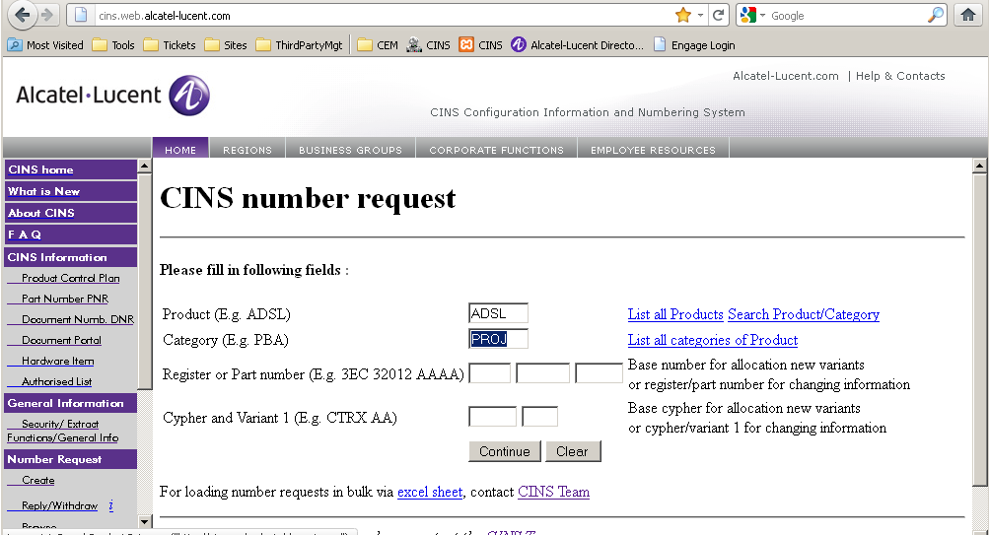
Number request (2)
http://http://cins.web.alcatel-lucent.com/
Create Number Request

Slide 14
Review and Approval
(Peer) Review: A review of a document by peers of the producers of the document for the purpose of identifying defects and improvements (CMM).
Approval: Decision by a management role to use the document as the basis for subsequent activities.

Slide 15
Document status flow
Document Author
Appraisal Authority
Release Authority
Reviewers
IP1
IP2
PD
OK
PD+
RL
OK
NOK
NOK
Document creation
Review
Approval
Check release criteria

Slide 16
Appraisal authority (AA)
Role that is responsible for the approval of a document
To be defined per document category

Slide 17
Release authority (RA)
Role responsible to verify if configuration management requirements are satisfied before the document is baselined (released)
To be defined per document category

Slide 18
Project management documents (typical situation)
Two types of project management documents
Documents that have to be baselined
E.g. Project Test strategy, Development baseline, Hardware index sheet…
Appraisal authority: Project Director
Release authority: Project Office
Documents that don’t have to be baselined
Reports, meeting minutes, action point list, …

Slide 19
Product documents
All product documents should be baselined.
Per document category it is defined which Control Board has the approval authority. This control board defines also the AA’s and RA’s:
Appraisal authority: competence project leader or Control Board
The AA takes the decision whether the contents of the document can be used as the basis for subsequent activities (i.e. whether the document can be baselined).
Release authority: configuration- or document control
The RA verifies that
the document has been reviewed (comment are not in the open status)
the attributes (number, status, edition) are correct.
The RA should be independent of the project

Slide 20

Document Status and Edition/proposal numbering
Comment,
Reviewer_x
CINS
e.g. 3EQ-00501-AAAA
Document Attributes:
Title, Author, Appraisal Authority
History, Format, ACL, ….
IP1- 01P01
IP1- 02P01
IP1- 01P02
Review
IP2- 02P01
PD - 01P03
Review
IP2- 01P02
IP2- 02P02
IP2- 01P03
IP2- 02P03
Edition
Status
Proposal
Approval
PD - 01P03
Approval
PD - 02P03
PD+ - 01P03
PD+ - 02P03
Release
Release
RL - 01
RL - 02

Slide 21
WebLibrary Document attributes
Document attributes
Number
Title
Author(s) of the document set
Author of a specific document edition
Appraisal Authority
Release Authority
Format (MS Word, HTML, zip, txt, GIF, …)
Access Control List (control read access)
Comments
History list
including access to sources of previous proposals

Slide 22
Basic features of WebLibrary

Slide 23
Basic features of WebLibrary
How to search for a document
How to use by Readers
How to use by Authors

Slide 24
Web Library - Home Page (actual layout could be different)
Web Library Home Page : http://ct.web.alcatel-lucent.com/scm-lib4/
New
Doc
Searches via CINS in all archives
that are connected to CINS
Search
via CINS
Local
Search
Searches only for documents
stored in the WebLibrary archive

Slide 25
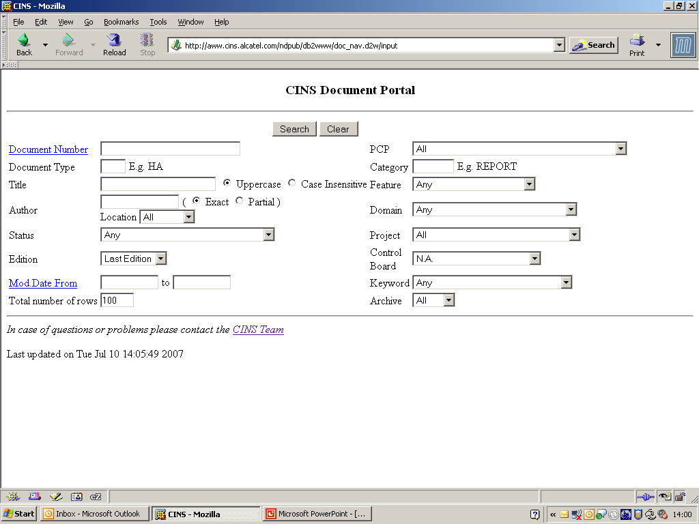
Web Library – CINS Document Portal Search panel

Slide 26
WebLibrary – CINS Document Portal Search
Searches for documents via CINS PDM-system; this allows the user to search for a document without knowing in what archive it is stored
Allows to find documents in all archives that are integrated with CINS
E.g.: DMS, WebLibrary, CMCS, EDMS, LARS, SMAPS, …
Archives not integrated with CINS can not be found via the CINS document portal. E.g.: CDMS
Note:
Integrating with CINS is easy…

Slide 27
Web Library Home Page : http://ct.web.alcatel-lucent.com/scm-lib4/
New
Doc
Search
Doc
Search of documents in the Web Library
Search string: enter either
part of title or author or keywords of document (e.g. “AVIP”)
part of the Alcatel number (CINS) (e.g. “3EQ-00313”)
part of the Alcatel number using wild cards (e.g. “3EQ-…..-….-AD…”)

Slide 28
Web Library - Search a document - by number
Note :
Always use hyphens as
separators when searching
an ALU code
Part of
ALU number
Search string: enter either
part of the ALU number (e.g. “3EQ-00313”)
part of the ALU number using wild cards (e.g. “3EQ-…..-….-AD…”)
part of title or author or keywords of document (e.g. “Index”, Category “PRL”)
any of the above criteria can be combined with a category filter
Query
Result
Notes:
4

Slide 29
Web Library Overview - Search a document - wild cards
Note :
Always use hyphens as
separators when entering
an ALU code
All documents of
type “DP”
Search string: enter either
part of the CINS number (e.g. “3EQ-00313”)
part of the ALU number using wild cards (e.g. “3EQ-…..-….-AD…”)
part of title or author or keywords of document (e.g. “Index”, Category “PRL”)
any of the above criteria can be combined with a category filter
Query
Result
Notes:
4

Slide 30
Web Library - Search a document - string
String “M0” in title,
author, keyword
In case of search on author
use no spaces and all lower cases
when typing the name.
Filter: only docs
with category
ADSL/MA
Query
Result
Search string: enter either
part of the CINS number (e.g. “3EQ-00313”)
part of the ALU number using wild cards (e.g. “3EQ-…..-….-AD…”)
part of title or author or keywords of document (e.g. “Index”, Category “PRL”)
any of the above criteria can be combined with a category filter
Notes:
4
If a n author has a substring “index” in his/her name, then it will be selected (in case the document satisfies the Category criteria)
e.g Author’s name Linde Xsara (username lindexsara)

Slide 31
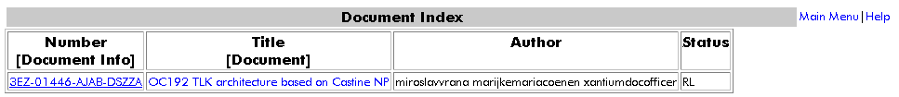
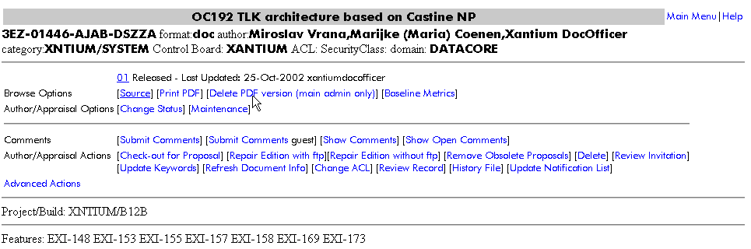
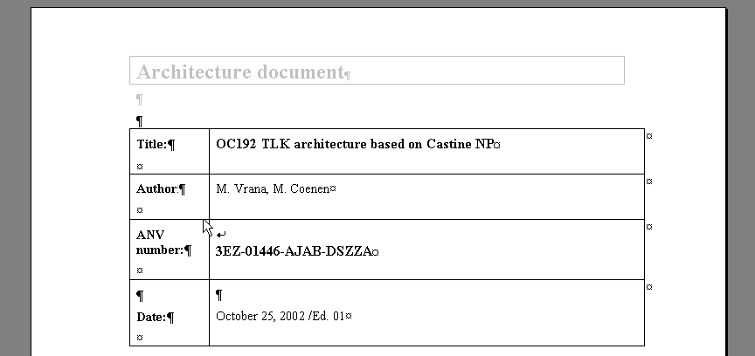
Web Library - Search Results - Navigation
Query
Result
Shows the Reader Info Page
Opens immediately the last Released edition
See next slide
Notes:
The Reader Info Page is one of the most important panels, it contains all menu buttons that apply to the selected document container.
The Helper applications for different file types can found in Netscape:
Edit>Preferences>Navigator>Applications

Slide 32
Web Library Overview - Major Features for Readers
Now that we can find a document, we will explain features important for Readers
Reader Info Page
Uniform panel for each document with as menu buttons :
Read a version of the document
Comment (review and approval support)
Submit a comment to the document (author is automatically notified by email)
View all available comments to the document
View metrics of number of comments
View history of document
Features of HTML-documents
HTML documents are formatted dynamically from the HTML source
Following is automatically generated at display time
Document Header (same look and feel)
Table of Contents (chapter numbering and contents list)
Hyperlinks to documents with the CINS-number (e.g. 3EQ-00344-AAAA-QMAAA)
A section “References” to the CINS-numbered documents
A Glossary of abbreviations and hyperlinks to their descriptions
Hyperlinks to DDTS tickets and CHARTS forms
First we will explain the menu buttons of the Reader Info Page
Notes:
4

Slide 33
Web Library - Reader’s Info page
Word document
Title as entered in Weblib
Opens Edition 03 Released
Opens originally downloaded
Source file.
Useful if opening is for editing
purposes and original was
converted to PDF
an html document
Ed03 has been created by Steve Wilms
Opens Comments panel
as registered users or
as guest
See section on
Review
Shows Comments given to this document
(all editions; open, closed comments)
See section on
Review
Notes:
4
In case there is no Released document yet, then only 1 document is shown of course
If you want to look to older editions, then look in the History file

Slide 34
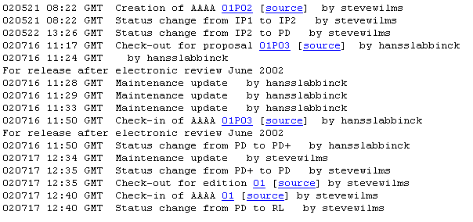
Web Library - Showing History of document
Sources available
till a purge is done by Author
First version in Weblib was
Proposal 01P02

Slide 35
Web Library - for Authors
Web Library - Commands for Authors
Document handling
Enter a new document
Limit the document access (Read Protection). The preferred way is to use security classes in CINS.
Make an update of a document
Change the document status
Maintenance actions
Change document attributes (format, author, etc)
e.g. How to give (co-)authorship

Slide 36
Web Library - for Authors
Prerequisite
Need to know the Document number (e.g. 3EQ-00508-AAAA-TTAAA)

Slide 37
Web Library - for Authors - Enter a new document - Specify
Enter the first proposal of a new document
CIL authentication required
to enter a new document
Title as shown in query lists and
in HTML doc headers
Ed 01 P01
Doc Nr
No Access Control List ACL)
selected = No Read Protection
PowerPoint
Specific Domain selection NOT required

Slide 38
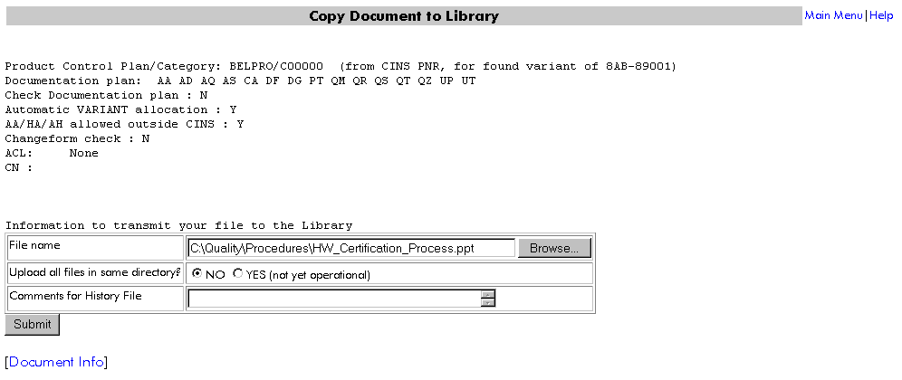
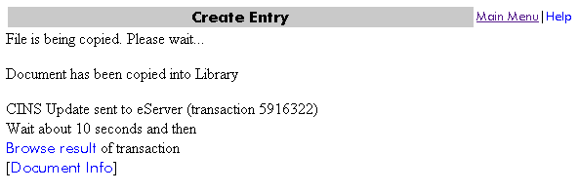
Web Library - for Authors - Enter a new document - Upload
Filename&path where the source file
can be found
Info for History file, e.g. a copy of a mail
to build up the history file automatically.
Shows the Reader’s Info Page

Slide 39
Web Library - Authors - Updating a Document
See next slides
Check-out for Proposal
The author(s) can enter an
upgrade of a document via a proposal version upstep

Slide 40
Web Library - Authors - Updating a document - Check Out
Before proposal version step-up a Check-Out of the existing version is required.
Action can only be performed by the Author(s) of the document or the appraisal/release authorities.

Slide 41
Web Library - Authors - Updating a document - Check In
Ed 01 RL
Click on Refresh Doc Info
and a new menu appears:
Check-in buttons
Undo Check-out button
instead of Check-out for Proposal
Info for History file, e.g. a copy of a mail
to build up the history file automatically.
Ed 02 P01

Slide 42
Web Library - Authors - Updating the document Status
Updating the document status in relation to the Document Life Cycle.
Action can only be performed by the Author(s) of the document or the appraisal/release authorities.
Click on Change Status to
do a step-up from
IP1 to IP2 status
Select status IP2
Status changed to IP2

Slide 43
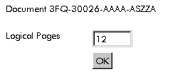
Web Library - Authors - Entering number of Logical Pages
At status IP2, the author must enter the number of new and changed logical pages.
Click on Update Keywords
Fill out number of
new and changed logical pages

Slide 44
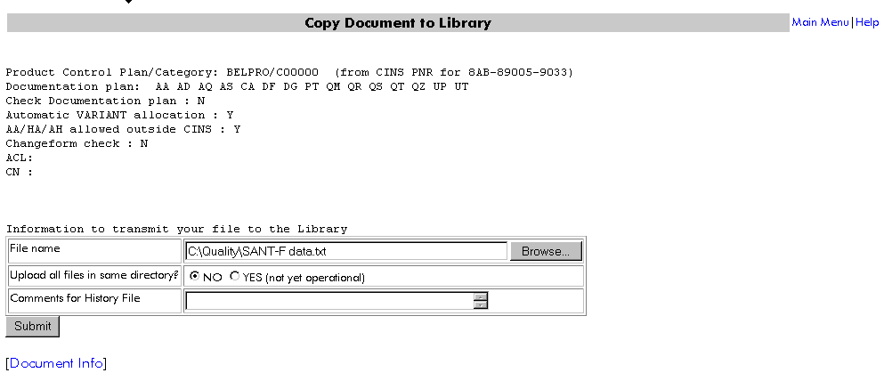
Web Library - Authors - Updating a Non-configurable document
A document that has no version control has always Ed 00 and is always overwritten
Download function is available
Instead of Check-in, the Update function is available
Use Download field to store
the source file to a local disc
To load a new version click on
Update
Submit new version

Slide 45
Web Library - Authors - Document Maintenance options
Attributes of a document can be changed via the Maintenance button
Action can only be performed by the Author(s) of the document or the control board related Administrator.
Change of Title
Addition of extra Author(s) :
As author name use the CIL username, but without spaces and with lower cases.

Slide 46
Review records in WebLibrary

Slide 47
Review records in WebLibrary
General Remarks
Review Procedure using WebLib
Document Editing (status IP1)
Document Formal Peer Review (status IP2)
Document Formal Peer Review Finished (status PD)
Detailed information
Author sends Review Invitation
Reviewer receives Review Invitation in mailbox
Reviewer Submits Review Comments
Author Classifies and Closes Comments
Reviewer/Author Display Comments

Slide 48
General Remarks
Review metrics will be extracted out of WebLib
# Malfunctions
Review effort
logical pages
WebLib comments before IP2 are excluded from the metrics
if procedure is used as described in this training

Slide 49
Review process in WebLib Overview
Document Author
Appraisal Authority
Release Authority
Final Peer Review
for edition has been finished.
Doc has been updated
Stable draft.
Doc ready for
peer review
Unstable draft
Reviewers
IP1
IP2
PD
OK
PD+
RL
OK
NOK
NOK
01P01 …. 01Pxx
01Pyy
01Pyy
01
Editing Phase
(prep. the document for
stable draft,
input for peer review)
Formal
Peer
Review
Approval
Check Configuration
Management aspects
01Pxx = proposal xx for edition 01

Slide 50
Review Procedure via WebLib Document Editing (status IP1)
Author may organize workshops to enable the document to evolve to a stable draft. Weblib comment mechanism can be used for this.
Author checks in document in status IP1 (= unstable draft)
author sends e-mail review invitation via WebLib [Review Invitation]
reviewers
review deadline
scope of review
Reviewers submit review comments to document [Submit Comments]
each reviewer groups all comments in 1 WebLib comment
review effort is not filled out
Author updates documents based on received comments
Author classifies all comments with a severity different from “Malfunction”
Author indicates status of document (see further)
[Update Status/Classification]
Author closes each comment
This process can have different iterations, i.e. proposal 01, 02 , … . Number of iterations should be kept to a minimum.
Status remains IP1 until the document is stable enough for formal peer review.
Will not be
counted for
metrics

Slide 51
Review Procedure via WebLib Document Formal Peer Review (status IP2)
If document is stable enough to be distributed for a formal peer review, the author checks in the document in status IP2.
Author sends e-mail review invitation via WebLib [Review Invitation]
mandatory reviewers = limited list of people which are mandatory in order to have an effective review of the document
review deadline = date on which review must be finished
scope of review = explanation on what has been changed in the document, what the review should adress, scope for each reviewer (free format), review checklist
Reviewers submit review comments to document
if you have no review comments at all : submit a comment with title “No Comments”
if you will not review the document, delegate your review to a peer who is able to represent you
if you will not be able to review before the review deadline, inform the author
indicate for each comment the severity classification [Update Status/Classification] . Definitions see later.
all editorial comments (per reviewer) may be grouped in 1 WebLib comment
Malfunctions : each comment must be put in a separate WebLib comment
each reviewer fills out his review effort in 1 of his review comments (WebLib sums up review efforts over all comments)
When your review is finished: submit a comment with title “No more comments”

Slide 52
Review Procedure via WebLib Document Formal Peer Review (status IP2) (cont’d)
Author
indicates the severity classification for each comment [Update Status/Classification]. Definitions see later.
indicates the status for each comment [Update Status/Classification]
adds remark to comment (mandatory in case comment is rejected, deferred or duplicate) [Add Remark to Comment]
review invitation and “No comments” comments are classified with severity “None”, status “Info”
updates document and checks in new proposal
closes the comments

Slide 53
Review Procedure via WebLib Defect Severity Classification
MALF = Malfunction = a defect that can cause the shipped product to
not conform to committed customer requirements
stop working
produce incorrect results
lose functional capabilities (e.g. contributing to reduced reliability or availability)
degrade performance
show operational difficulties in its use
NFM = not to be used !!!
EDIT = Editorial = all defects not classified as malfunction
None
reviewer : if you do not have an idea on the defect gravity
author : may only be used to classify the review invitation or “No comments” comments, all other official review comments must get either MALF or EDIT
CR : not to be used !!!

Slide 54
Review Procedure via WebLib Formal Peer Review Finished (status PD)
Author changes document status to PD only in case
all reviews for the edition have been finished
all mandatory reviewers have submitted comments
all comments are classified (status and severity)

Slide 55
Detailed Information Author sends Review Invitation
If other people need to be
informed (CC) that the review
invitation is send out then forward
the review invitation to them
(after it has been sent out to the mandatory reviewers)
Mail to all mandatory reviewers
email addresses
of mandatory reviewers
all separated by a space, (just type names)
Invtation
Fill out manually : Mandatory reviewers list (optional because is already in distibution list)
Review Deadline
Auto-generated text.
You can add here extra info, eg scope of review, reason for review, ...

Slide 56
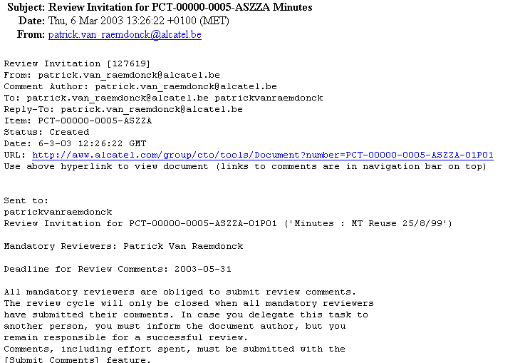
Detailed Information Reviewer gets Review Invitation in mailbox (actual lay-out may be different)
Brief Description
Automatically generated
Click Here
Direct link
to source of
WebLib doc

Slide 57
Detailed Information Reviewer Submits Review Comments
Concise but clear short
description of problem
Optional
Clearly state the problem

Slide 58
Detailed Information Reviewer Submits Review Comments
After you have submitted a comment, use the [BACK] button of your Internet Explorer to submit a new comment
OR :
[Submit Comment] : you will have to re-enter your email adress

Slide 59
Detailed Information Author Classifies Comments
List of
comments
.15 = 15 minutes
.20 = 20 minutes
Close Comment
Notes:
4

Slide 60
Detailed Information Reviewer/Author Display Comments
List of
comments
Reader Info
page
comment
answer
Allows you to add your comments
into the reviewer’s comment text
Notes:
4

Slide 61
Review Metrics - List and status of comments
Comment
submitted on
Ref. to full comment
Against
proposal x
Status and
Gravity
Notes:
4

Slide 62
Review Metrics - # of defects, logical pages, effectiveness, effort
ex. => 3FQ-30026-AAAA-ASZZA :
(1) : 15 comments closed which are malfunctions, 33 comments closed in total
(2) : 0 comments open which are malfunctions, 1 comments open in total
(3) : review effort in HH.MM
(4) : 1.3 Malfunctions / Logical Page = 10/12
Notes:
4

Slide 63
Document approval and release in WebLibrary

Slide 64
Document approval and release: overview (1)
For Appraisal Authority (AA)
ALU defines the role of AA in standard 1AA-00007-0000-ASZZA. Basically the AA approves/rejects a document w.r.t. technical content. He or/she can a person that representes a Change Review Board, Project Meeting,…
The actions an AA does are:
Verify review results
If approval OK: set document status to PD+
If approval not OK:
Record remarks as comments in the WebLibrary
Set status to IP2

Slide 65
Document approval and release: overview (2)
For Release Authority (RA)
ALU defines the role of RA in standard 1AA-00007-0000-ASZZA. Basically the RA publishes the document and is responisble for the configuration management (edition control, …)
The actions an RA does are:
Monitor documents for this Control Board that are put in status PD+
If release criteria are satisfied, put status to RL. These minimum criteria are:
Does the footer of the document (number, edition, status) correspond to what is registered in Weblib
Is the document reviewed? This can be proven to the RA via several ways, depending on the procedures applicable for the Control Bord. Examples:
There is a review invitation which has been closed
Comments have been actioned
There is a comment indicating that an off-line review has been done
The RA is aware that the review is done or not applicable (e.g. reports)
If release criteria are not satisfied, notify author and set status to PD
For Author
Notify all involved people of the release of the document

Slide 66
Verify review results
Notes:
4

Slide 67
Approve the document: set status to PD+
Action can only be performed by the Approval authorities of the document
Click on Change Status to
do a step-up from
PD to PD+ status
Select status PD+
Status changed to PD+ a.k.a.
PD and selected for Control Board

Slide 68
Reject the document
Step 1 – Record your remarks as comments in the WebLibrary (see next slide)
Document author will be notified automatically
Step 2 – Set status to IP2

Slide 69
Reject the document: Step 1 – Record your remarks
Author will be
notified automatically
of the remarks
Concise but clear short
description of problem
Optional
Clearly state the reason for rejection

Slide 70
Reject the document: Step 2 – Set status to IP2
Click on Change Status to
do change status from
PD to IP2
Select status IP2
Status changed to IP2

Slide 71
Release of a document
The Release authority monitors periodically (daily) the documents that are put in status PD+ (a.k.a. “PD and selected for Control Board”)
The author does not have to explicitly request to release a document, except for very urgent situations
The Release Authority checks if the release criteria are satisfied (e.g. [3FQ-30015-AAAE-ASZZA]
If release criteria are OK, the document status is set to RL
The document author is not explicitly notified of this
If release criteria are not OK,
Issues are entered as comments in WebLibrary
The document author is automatically notified
Status is set to PD
When the author has resolved the issues, he needs to request explicitly to the Release Authority to release the document

Slide 72
Notification of release
When the document has been put in status RL, the document author notifies all involved people of the release of the document. This can be done:
Manually: Via email
Automatically: via the automatic notification mechanisms on the document info pages.
Purpose: people that need to use this document as input, should be aware that the baselined document is available

Slide 73
Advanced WebLibrary Features

Slide 74
Advanced WebLibrary features
Specific features for HTML documents
Document security
Document delivery via mail
Document bulk transfer
PDF as view format
Weblib as FAQ register
Weblib as Action Point register
Electronic approval via Weblib
Notification
Read Protection with ACL

Slide 75
All : reading HTML docs
HTML document
Browse Options
Opens Edition 04 in internet Browser in 1 frame window.
It contains the complete doc : Contents, References, Glossary
To be used to PRINT document
Opens Edition 04 in internet Browser in 3 frames to facilitate browsing on a SCREEN.
Edition, Status
Opens Edition 04 in internet Browser
in 3 frames to facilitate browsing on a SCREEN.
Author, Date
Author,Date
Title
References, glossary,...
References, glossary,...
Table
of
Contents
Doc Contents
Notes:
4

Slide 76
Author : writing HTML documents
HTML documents are formatted dynamically from the HTML source
Following is automatically generated at display time (after doc is checked in WebLib)
Document Header (same look and feel)
Table of Contents (chapter numbering and contents list)
Hyperlinks to documents with CINS-number (e.g. 3EQ-00344-AAAA-QMAAA)
A section “References” to the CINS-numbered documents
A Glossary of abbreviations and hyperlinks to their descriptions
Hyperlinks to DDTS tickets and CHARTS forms
The source of the HTML document is different from the browser display
No
References, Glossary,
TOC, figures
Source text
as entered by
the author

Slide 77
Author : writing HTML documents - What NOT to do
What NOT to do
Do NOT create explicit hyperlinks to documents with a CINS Number.
Each document number (e.g. 8AB-86000-0002-ASAAA) gets automatically a hyperlink to that document.
Do NOT number your sections explicitly. Section number are added automatically.
Do NOT create a "Table of Contents". It is generated automatically based on the HTML headers.
Do NOT create a "References" section for documents in the Web Library. It is generated automatically.
Do NOT create a "Glossary" section. It is generated automatically.
Do NOT create a Header section with author, date and copyright notice.
It is deducted from the document attributes.
If you update an existing document, do NOT start from the default view, use the check-out function or start from from the “Source”.
You don’t need to create a "History" section. There is a history available in the Web Library.
Next slides show the source HTML document and how it looks in the browser.

Slide 78
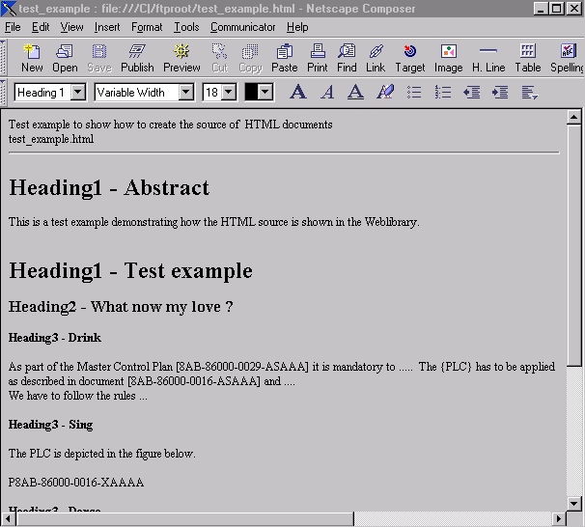
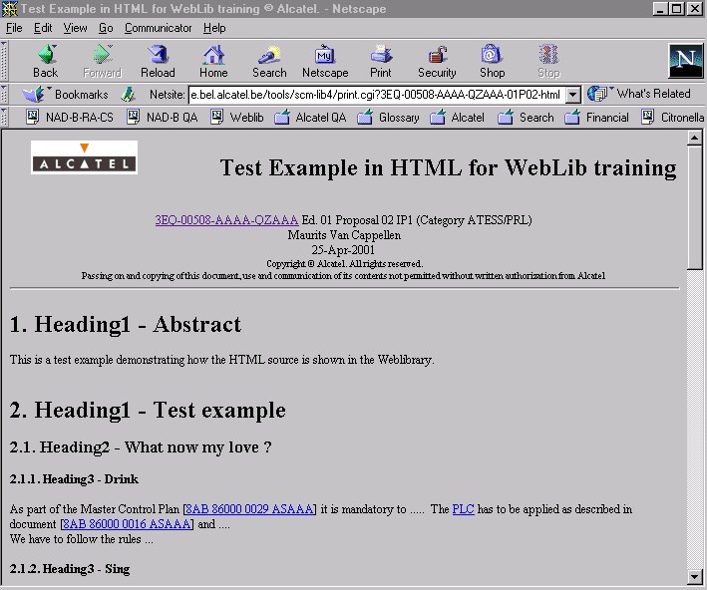
Author : writing HTML documents
Source
WebLib Browser
Disregarded
info
Start with
Horizontal Line
Generated Title
(based on author’s input
during check-in)
Section
Numbering
Hyperlinks
(only for CINS nbrs)
Notes:
Document Header
For each document, the document header is generated automatically and appended at the beginning.
Do not add a document header by your own.
Start your document with
1) A paragraph with the paragraph type "heading 1" containing the document title (<H1>) -> then the document itself is listed in the Reference too.
2) A horizontal line (<HR>)

Slide 79
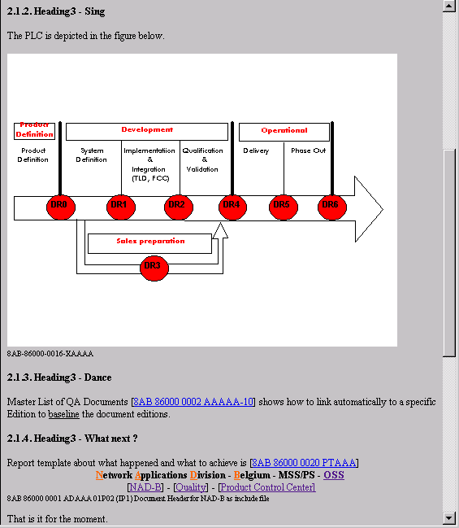
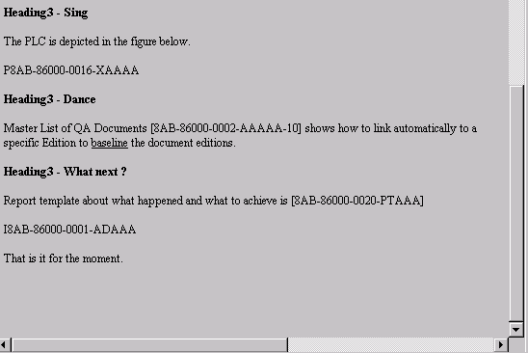
Author : writing HTML documents
Source
WebLib Browser
The pictures and include files
must be checked-in in WebLib
Include Picture (GIF, JPG)
P<number>
without legend below:
G<number>
Include file (html)
I<number>
without legend below:
M<number>
Released docs have priority over IP1, IP2, PD or PD+.
Add –LA after doc number to include latest proposal instead. (e.g. I8AB-86000-0001-ADAAA-LA )
Notes:
Restrictions for documents, that have to be released:
Before releasing a document, all related figures have to be released first
The use of include-files is not allowed unless a specific Edition is referenced.
These restrictions are necessary to ensure a proper configuration management of the documents

Slide 80
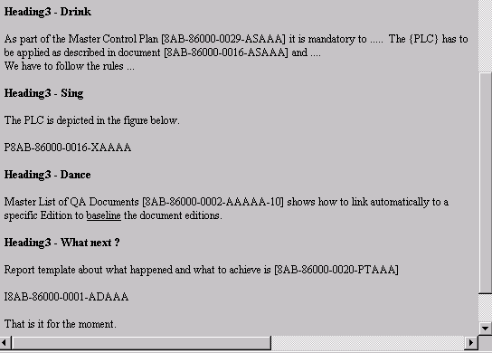
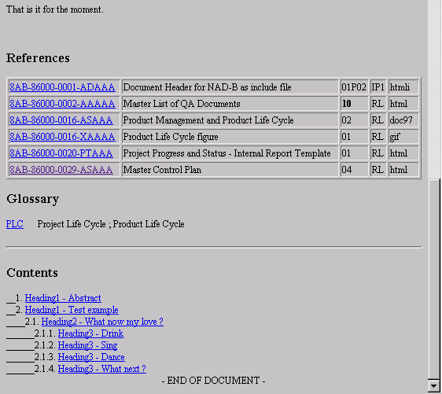
Author : writing HTML documents
Source
WebLib Browser
List of resolved
References + Status
Glossary
Baseline ref.
Ed 10
Table of Contents

Slide 81
Author : writing HTML documents
Figures:
Each figure must be checked in into the Web Lib separately (e.g. 8AB-86000-0016-XAAAA)
If multiple figures need to be stored for a document, use the DTI’s XA, XB, ... , XZ
Syntax to insert the figure: P8AB-86000-0016-XAAAA
Syntax to insert it without a legend (doc number) below it: G8AB-86000-0016-XAAAA
Include-Files:
to use the same fragment in several documents (e.g. headers with hyperlinks to homepages etc)
Store parts of HTML code as separate files (File type: “HTMLi“)
Syntax to include this fragment into a document: I8AB-86000-0001-ADAAA
Syntax to include it without a legend below it: M8AB-86000-0001-ADAAA
Syntax to include latest proposal into a document: I8AB-86000-0001-ADAAA-LA
Other allowed syntax: I8AB-86000-0001-ADAAA-IP1, I8AB-86000-0001-ADAAA-01P03, …
Table of Contents
Is generated automatically and appended at the end. Numbering of headlines is done automatically.
Do not add a contents section by your own. Do not number the headings of chapters by your own. Use the paragraph type "heading”.

Slide 82
Author : writing HTML documents
References and Hyperlinks:
The referenced documents section is generated automatically and appended at the end.
All ALU coded document-numbers are automatically changed to hyperlinks to the document in the Web Library. Please note that linking to related libraries has been switched of for performance reasons.
Use the syntax for document-numbers as: [3EQ-00104-AAAA-ASZZA] -> Is converted to an hyperlink to show Reader Info page
Use “.” as wildcard to get a list of documents: [8AB-86...-….-ASAAA] -> Is converted to an hyperlink with a QUERY
Hyperlinks to documents without ALU-document-numbers or which are not stored in the Web Library must be added manually.
References inside the document itself (e.g. to another chapter) have to be made by placing an "anchor" (# target) and making a hyperlink to it.
Glossary
you can put abbreviations and acronyms between {}. They will show up in the document’s glossary section together with their definition from the glossary.
You can add/update items to the glossary via http://ct.web.alcatel-lucent.com/glossary/

Slide 83
Web Library - Document Security (1)
Restricted access to a document can be defined.
Done via CINS and/or Weblib.
Restricted access can be set per subgroup of documents :
Per Category of documents within a product line (system) :
E.g. documents of category HW-HDS for system XNTIUM
Per Document Type :
E.g. documents of category HW-HDS for system XNTIUM of type PE
Per document range (register number) :
E.g. documents range 3AF 00001
Per individual Document
Per Document Group
Creating a list of people with access to a subgroup of documents :
A Security Class is to be created :
Please create a ticket (see at bottom of weblib homepage)

Slide 84
Web Library - Document Security (2)
Overview of existing Document Security can be found via CINS
CINS homepage
Click on ‘General Info’ and
then on
‘Document Security classes’

Slide 85
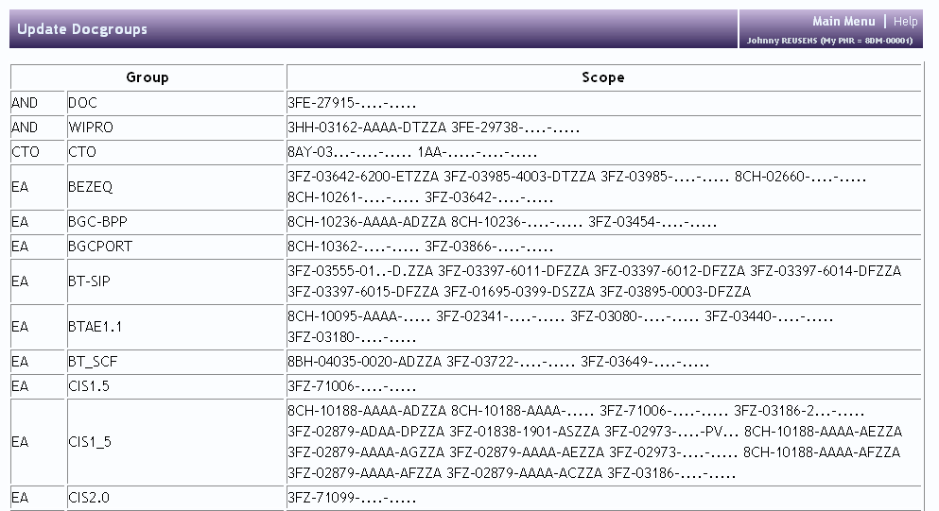
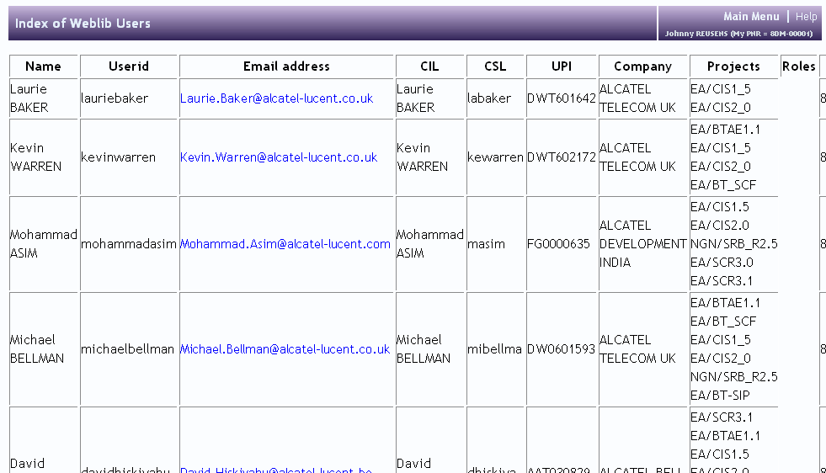
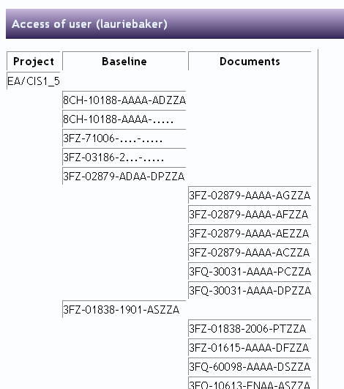
Web Library - Document Security (3)
Overview of existing Document Groups can be found via Weblib

Slide 86
Author : Document delivery via mail(1)
How-to deliver an MS-Word document identified 3FZ-12345-AAAA-DSZZA-01P01 and titled “My product specification’ to Weblib:
Rename the file to 3FZ-12345-AAAA-DSZZA-01P01-My product specification.doc
Mail this file to web.lib@alcatel-lucent.com (or search LIB Web in Outlook)
Read the reply mail with the success/fail message. It can take up to 10 minutes for the reply-mail to arrive.
Remarks:
You can deliver several documents with 1 mail.
Size of documents is limited to the size of attachments you can send via e-mail.
Status becomes IP.
All checks done via interactive delivery apply.

Slide 87
Author : Document delivery via mail(2)
There are 2 other ways to deliver a document via mail. In both cases you just mail one or more attachments to weblib. The 2 ways are:
1) nothing special in the “subject”:
Weblib will detect you userid and look-up you personal ANV number (e.g.: 8DM-12345).
It will find the next unused variant starting with “ZZZZ” and give it docype UAZZA.
E.g. sending 2 attachments, say “my first.doc” and “my second.doc” would result in documents
8DM-12345-ZZZZ-UAZZA-01 with title “my first” and
8DM-12345-ZZZY-UAZZA-01 with title “my second”
2) A glossary item in the subject with curly brackets, e.g.: {test1}. Weblib check the glossary (weblib -> related applications -> glossary) and pick-up the related number. Depending on this related number 2 things can happen:
The related number has the format: nxx-12345 (a register number). In this case weblib will start to number the attachements starting 0001 and use doctype UAZZA. So the two attachments mailed with {test1} in the subject of the mail would be numbered 8DM-00001-0001-UAZZA and 8DM-00001-0002-UAZZA since Glossary item “test1” has related number 8DM-00001.
The related number has the format: nxx-12345-vvvv (a partnumber). In this case weblib will start to number the attachements with doctypes, starting with UAZZA. So the two attachments mailed with {test2} in the subject of the mail would be numbered 8DM-00001-AAAA-UAZZA and 8DM-00001-AAAA-UBZZA, since Glossary item “test2” has related number 8DM-00001-AAAA

Slide 88
Administrator : Bulk transfer
You can bulk-transfer documents to an remote ftp-destination by:
1) creating a baseline containing the documents and their edition.
2) triggering and monitoring the result of the transfer.
Note: this action requires administration access and is not normally done by normal users.
The procedure is described in 3FQ-40195-AAAA-PCZZA .

Slide 89
Author: PDF as view format
The default view format for doc (MS-Word) files is pdf, where doc is then regarded as source format.
For many other formats (ppt, …) there is also a pdf version generated. If you want to make this the default view format:
1) check that the pdf is available: maintenance -> advance actions → index
2) make the default view version pdf: maintenance -> change view format to pdf

Slide 90
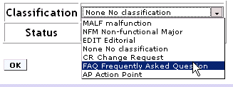
Weblib as FAQ register comments can be classified as FAQ
List of
comments
comment
Reader Info
page
Allows you to classify a comment as
Frequent Asked Question
Notes:
4

Slide 91
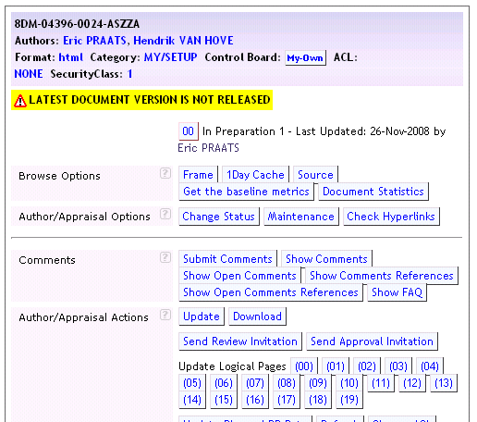
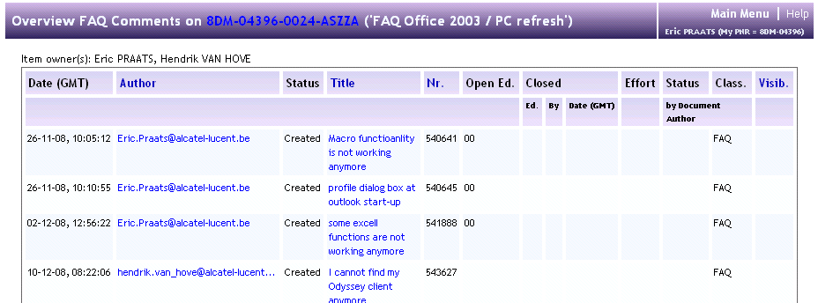
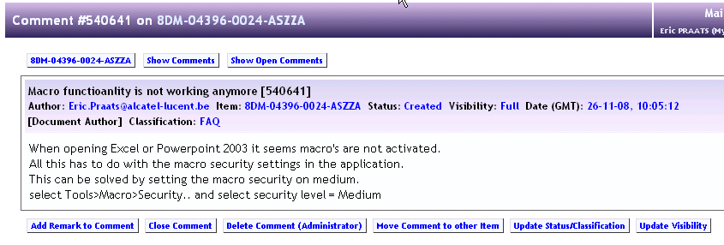
Weblib as FAQ register list of Frequent Asked Questions
List of
FAQs
Reader Info
page
FAQ
Allows you to provide a answers
For Frequent Asked Questions
Notes:
4

Slide 92
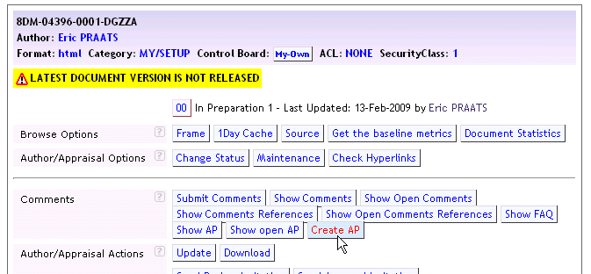
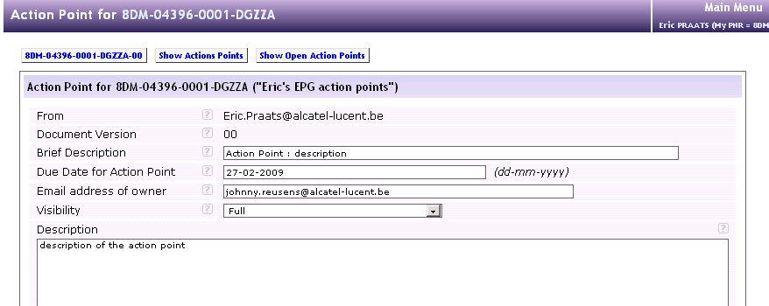
Weblib as action point register create action point
Only for
doc type DG !
Document owner and
Actionee is informed by mail
Action point short description
Action point due date
Action point actionee
Action point description

Slide 93
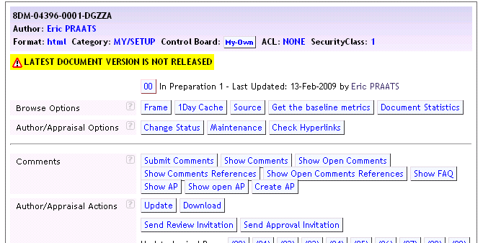
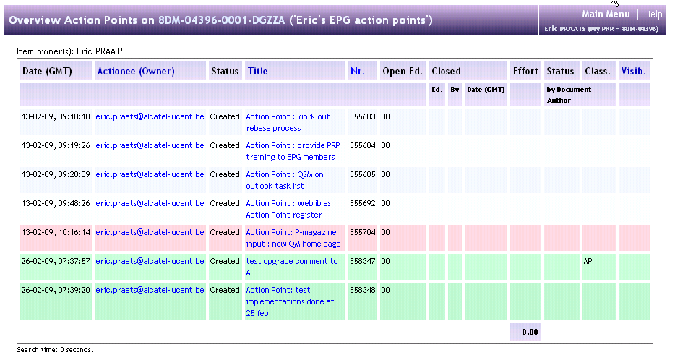
Weblib as action point register list of action points
Only for
doc type DG !
Colour code depending on due date

Slide 94
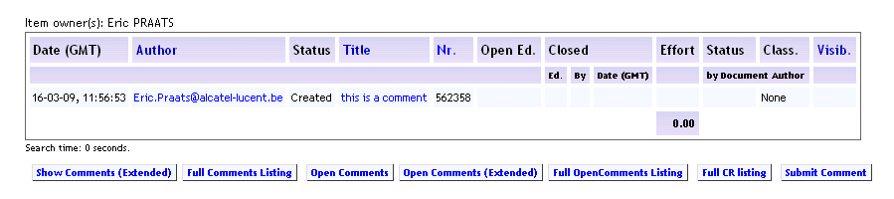
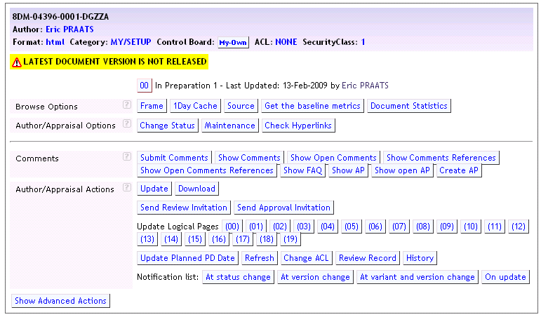
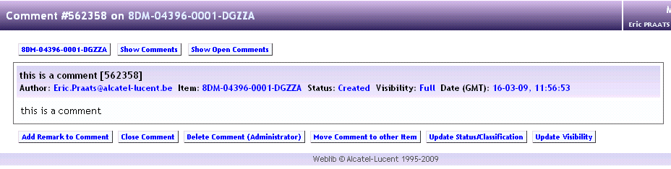
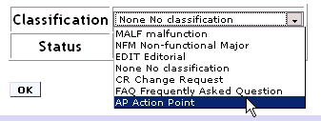
Weblib as action point register comments can be classified as AP
Only for
doc type DG !
List of
comments
comment
Reader Info
page
Allows you to classify a comment as
Action Point
Notes:
4

Slide 95
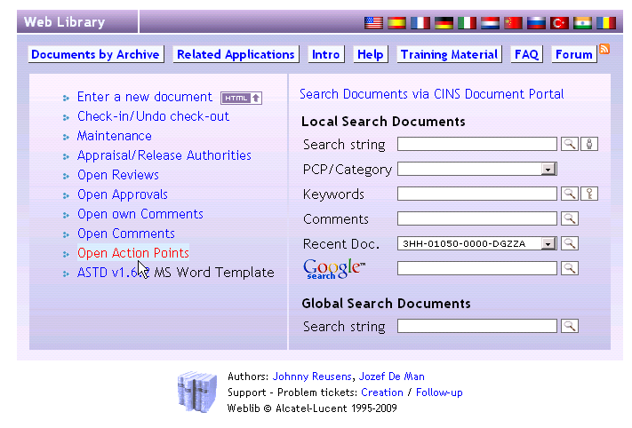
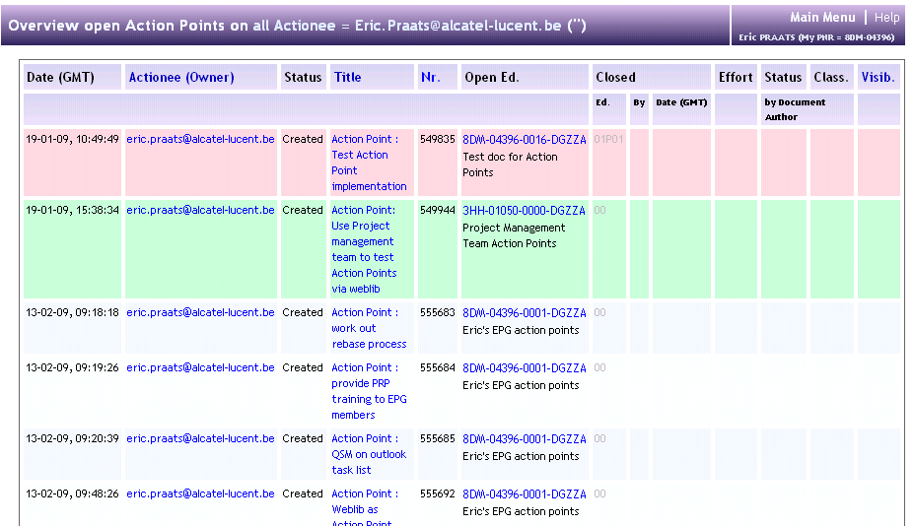
Weblib as action point register My open action points
List of my
Open action points
comment
Weblib
Main page
All action points assigned to you raised in different action point registers
Notes:
4

Slide 96
Electronic Approval via weblib
Weblib can be used to electronic sign-off/approve documents.
The author of the documents sends-out an approval invitation
The addressed approvers can approve or not approve a document by providing an approve/not-approve comment against the document. Also the option to approve/not-approve via mailreply is available
See next slides for an approval/not-approve scenario via mailreply

Slide 97
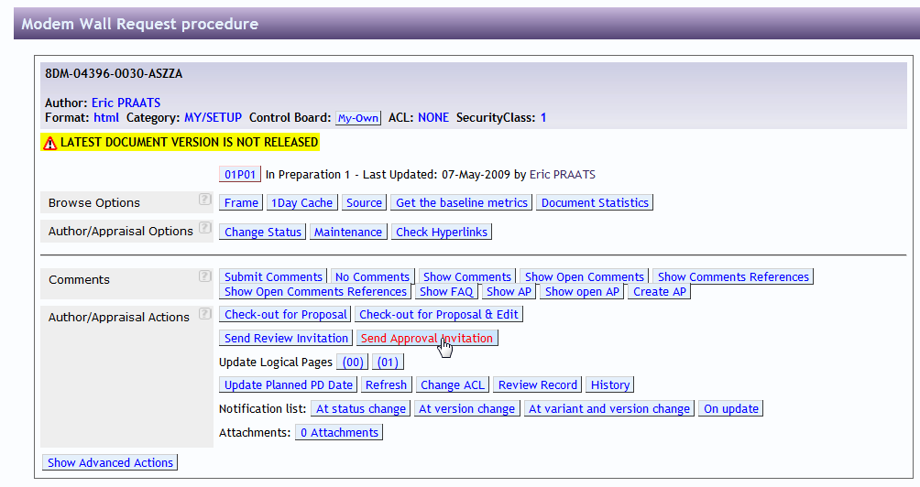
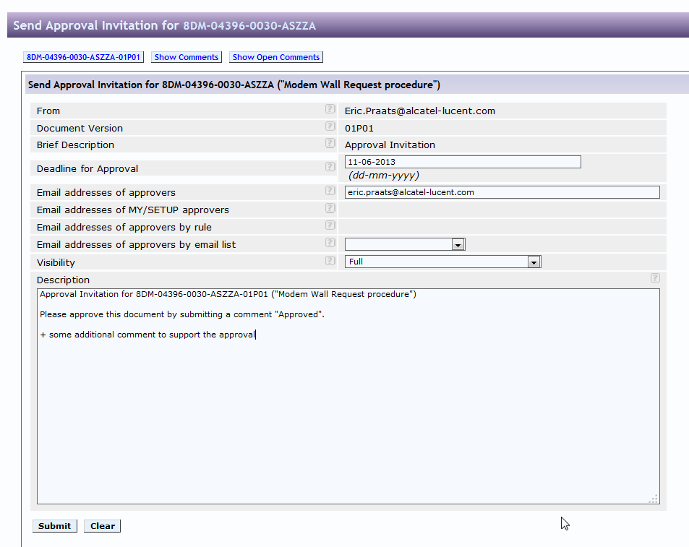
1. ‘Send approval invitation’ in weblib by author of the document
By Author

Slide 98
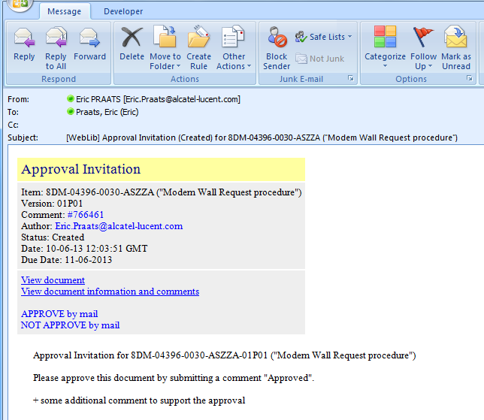
2. Read approval invitation and approve/not approve in mail browser by approver of the document
By Approver with CIL authentication 1. read the document
2. approve/not-approve

Slide 99
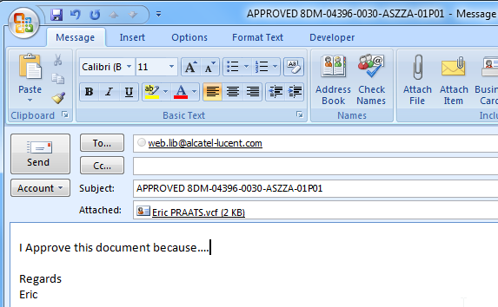
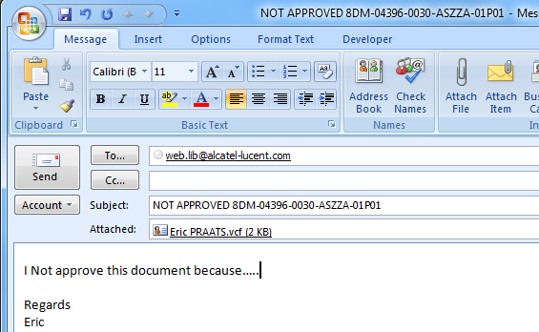
3. Provide additional information in mail browser by approver of the document
OR ..

Slide 100
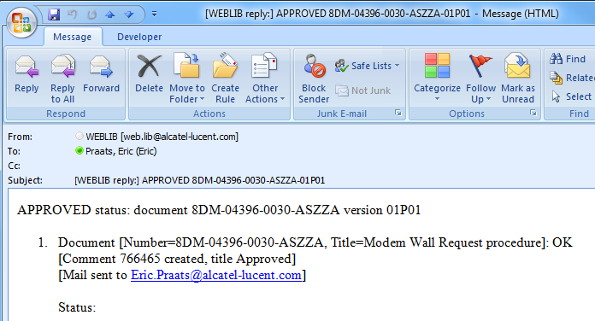
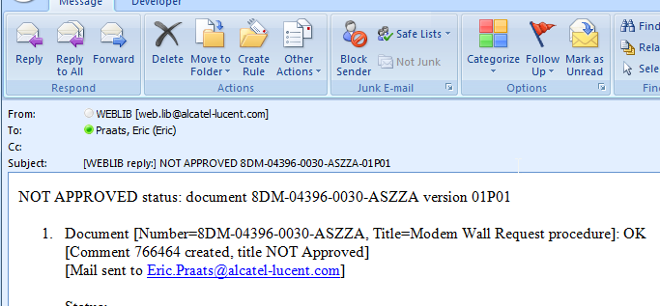
4. Confirmation of Reply approval invitation in mail browser of approver
OR..
Note: this can take some minutes as this is handled by a robot job

Slide 101
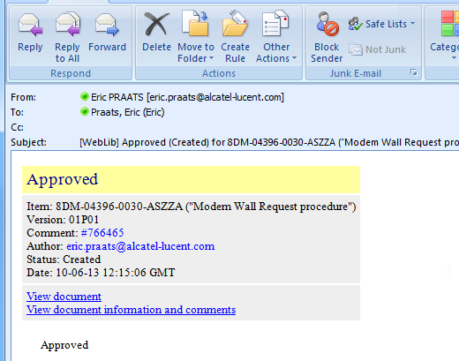
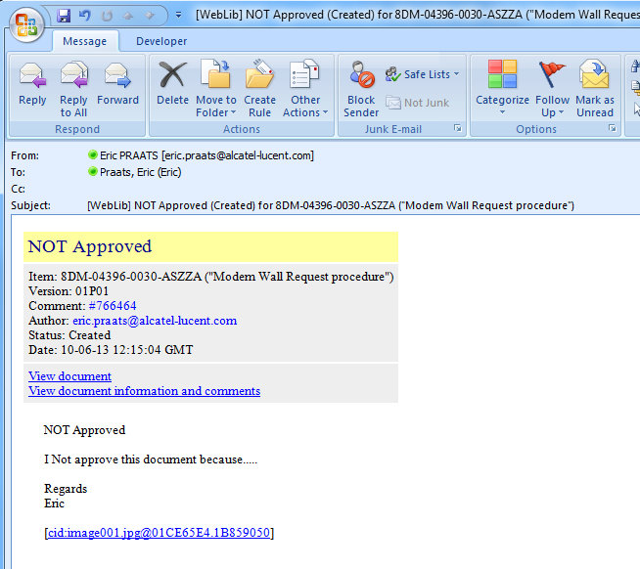
5. Reply of approval /disapproval in mail browser to author
OR..

Slide 102
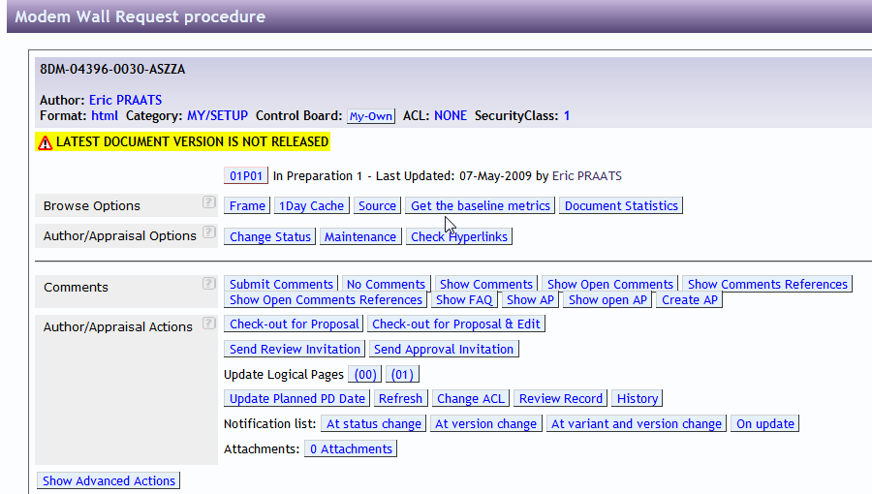
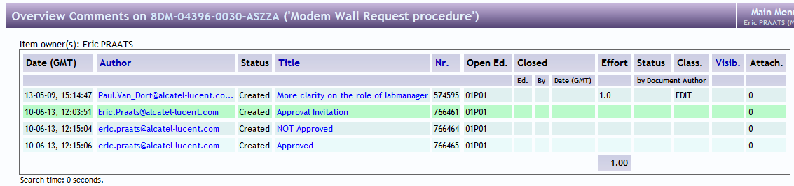
6. Collect feedback of approval invitation in weblib by author
By Author

Slide 103
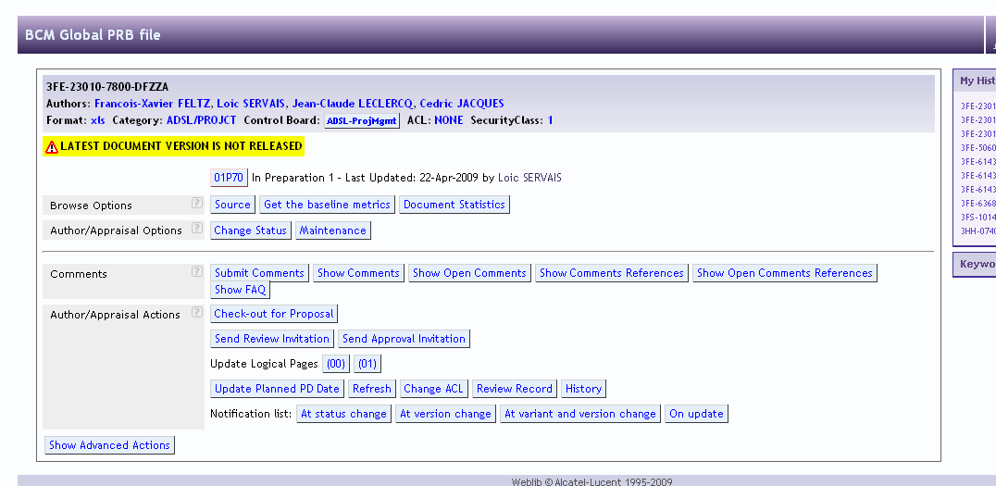
Notification
Notification of changes can be done at:
At status change: when the status changes, eg from PD to RL
At version change: when the version changes, eg from 01P01 to 01P02, or 01 to 02
At variant and version change: same as ‘At version change but also when a new variant is uploaded
Eg: AAAA exits and an ABAA is uploade.
On update: when a document is updated or replaced, no change in status or edition
Notes:
4

Slide 104
Read protection with ACL
A user can read-protect a document on individual basis. Steps to take are:
Create an ACL:
Make a txt file containing the userids (see note) of « allowed readers », one per line
Check-in using document type « AK » (AKZZA)
Update the lists:
Weblib -> maintenance -> update Selection List of ACL’s
Protect the document by either:
At check-in time, select the ACL
After check-in time, on the document’s info page -> Change ACL
Note:
A user should not forget to add himself/herself to the ACL, otherwise reading will be prevented!
Userid’s are: CIL but lowercase with dashes and spaces removed. So jeanpierredeville for Jean-Pierre Deville
Notes:
4

Slide 105
WebLibrary philosophy

Slide 106
Weblib is managed via the Community Source philosophy
Created by engineering people for engineering people
Administration is distributed via Control Boards:
Release documents, repair documents, user help done by user community
IT-support is done by IT
Back-up, server maintenance
IS-support is distributed
New features are implemented by the user community that needs it.

Slide 107
Extra Information

Slide 108
Extra Information
The forum serves for discussions and announcements
The FAQ serves as question/answer tool
The ticket system (bugzilla) serves as problem/change system
Number of users:
Geographical spread:
All locations
 | 2007-05 | 2008-01 | 2008-09 | 2009-03 | 2010-06 | 2012-02
Ex-Alcatel | 11303 | 14243 | 16776 | 18783 | 24127 | 32990
Ex-Lucent | 941 | 2213 | 3341 | 4208 | 5086 | 3971
Outside subco | 1211 | 1725 | 2115 | 2585 | 3748 | 5318
Total | 13455 | 18181 | 22232 | 25576 | 32961 | 42279

Slide 109
Management Summary
Why use weblib?

Slide 110
Management Summary: Why use weblib? Because it’s:
NSA rules compliant: bulk transfer of documents to remote ftp
Used by all BD’s in all Locations (ex-Alcatel and ex-Lucent)
Enabled for use by subcontractors and customers (“TPA-access”)
Secure for updating and reading (authorship and security classes)
CMM/ISO/TL9000 certified
Build by experienced users (Configuration Management -people and document practitioners) (1995-2007)
Got an interesting business model: only marginal costs, no central bottlenecks:
IT-part (Disks, network, servers) supported by IT with marginal costs
IS-part distributed according community source concept. Only open-source technology
DBA-part distributed
Future safe (Evolution to newco Numbering system, recognized by HQ, supported by several BD’s …)
Fast (approx 50 hits/second)
Highly productive (many features add to the productivity: baselining, mail delivery, notification mechanisms,…)
Expandable (ref. Recent linking to ex-Lucent FID)

Slide 111
References
[1AA-00001-0000-ASZZA] Alcatel-Lucent Numbering System
[1AA-00005-0000-ASZZA] Alcatel-Lucent Documentation System
[1AA-00151-0003-PHZZA] Document Type Indicators

Slide 112
Glossary
PDM: Product Data Management
DDTS: Defect Tracking System
DMS: Document Managment System
CINS: Configuration Information and Numbering System
LDAP: Lightweight Directory Access Protocol
CIL: Corporate Intranet Login
CMM: Capability Maturity Model
ACL: Access Control List
CMCS: Configuration Management Client Server
SMAPS: Standards Management Archiving and Puplishing System
LARS: Local Archiving System
EDMS: Electronic Document Management System

